Slide 1
Estimation
Kline Chapter 7
(skip 160-176, appendices)

Slide 2
Estimation
Estimation = the math that goes on behind the scenes to give you parameter numbers
Common types:
Maximum Likelihood (ML)
Asymptotically Distribution Free (ADF)
Unweighted Least Squares (ULS)
Two stage least squares (TSLS)

Slide 3
Max Like
Estimates are the ones that maximize the likelihood that the data were drawn from the population
Seems very abstract no?

Slide 4
Max Like
Normal theory method – Multivariate normality is assumed to use ML
Therefore it’s important to check your normality assumption – other types of estimations may work better for non-normal DVs (endogenous variables)

Slide 5
Max Like
Full information method – estimates are calculated all at the same time
Partial information methods calculate part, then use those to calculate the rest

Slide 6
Max Like
Fit function – the relationship between the sample covariances and estimated covariances
We want our fit function to be:
High if we are measuring how much they match (goodness of fit)
Low if we are measuring how much they mismatch (residuals)

Slide 7
Max Like
ML is an iterative process
The computer calculates a possible start solution, and then runs several times to create the largest ML match.
Start values – usually generated by the computer, but you can enter values if you are having problems converging to a solution

Slide 8
Max Like
Inadmissable solutions – you get numbers in your output but clearly parameters are not correct
You will get a warning on the notes for model page

Slide 9
Max Like
Heywood cases
Parameter estimates are illogical (huge)
Negative variance estimates
Just variances, covariances can be negative
Correlation estimates over 1 (SMCs)

Slide 10
Max Like
What’s happening?
Specification error
Nonidentification
Outliers
Small samples
Two indicators per latent (more is always better)
Bad start values (especially for errors)
Very low or high correlations (empirical under identification)

Slide 11
Max Like
Scale free/invariant
Means that if you change the scale with a linear transform, the model is still the same
Assumes unstandardized start variables
Otherwise you’d have standardized standardized estimates, weird.

Slide 12
Max Like
Interpretation of Estimates
Loadings/path coefficients – just like regression coefficients
Remember you can click the estimate to get help!
Error variances tell you how much variance is not accounted for by the model (so you want to be small)
The reverse is SMCs – tell you how much variance

Slide 13
Other Methods
For continuous variables with normal distributions
Generalized Least Squares (GLS)
Unweighted Least Squares (ULS)
Fully Weighted Least Squares (WLS)

Slide 14
Other Methods
ULS
Pros:
Does not require positive definite matrices
Robust initial estimates
Cons:
Not scale free
Not as efficient
All variables in the same scale

Slide 15
Other Methods
GLS
Pros:
Scale free
Faster computation time
Cons:
Not commonly used? If this runs so does ML.

Slide 16
Other Methods
Nonnormal data
In ML, estimates might be accurate, but SEs will be large (eek).
Model fit tends to be overestimated

Slide 17
Other Methods
Corrected normal method – uses ML but then adjusts the SEs to be normal (robust SE).
Satorra-Bentler statistic
Adjusts the chi square value from standard ML by the degree of kurtosis/skew
Corrected model test statistic

Slide 18
Other Methods
Bootstrapping!
We will cover this section later.

Slide 19
Other Methods
Asymptotically distribution free – ADF
(in the book he calls it arbitrary)
Estimates the skew/kurtosis in the data to generate a model
May not converge because of number of parameters to estimate
I’ve always found this to not be helpful.

Slide 20
Other Methods
Non continuous data
You can estimate some with non-continuous data, but you are better off switching to Mplus, which has robust (and automatic!) estimators for categorical data.
(so blah on page 178-182, as you can’t really do this in Amos easily).

Slide 21
Analysis Properties
Click on the abacus with buttons button to get started

Slide 22
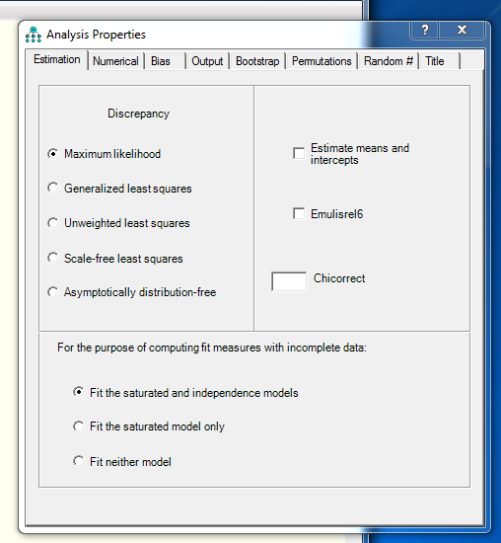

Slide 23
Estimation
You can pick the type of estimation on the left.
You can pick estimate means and intercepts on the right (must select for multigroup and models with missing data).
Look! You can turn off the output for the independence and saturated models.

Slide 24
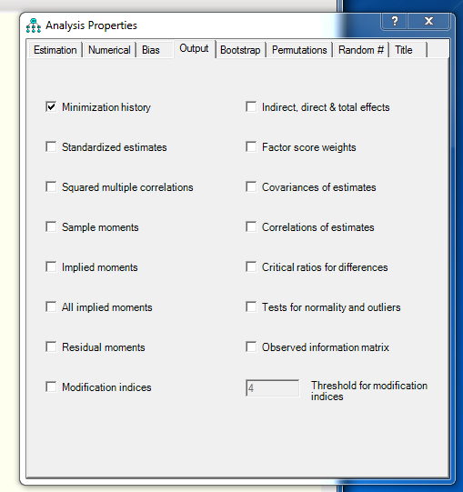

Slide 25
Output
Here you want to select (pretty much always):
Standardized estimates
Multiple correlations
Modification indices (won’t run with estimate means and intercepts on).
The rest of the options we’ll talk about as we go.

Slide 26
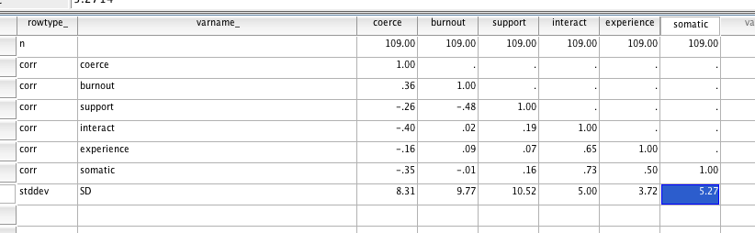
Entering Correlation Matrices
If you have means, the last row is label mean.

Slide 27
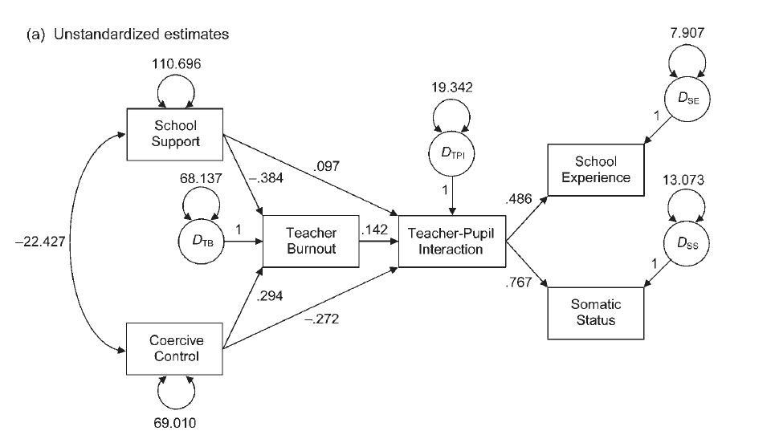
Teacher Example

Slide 28
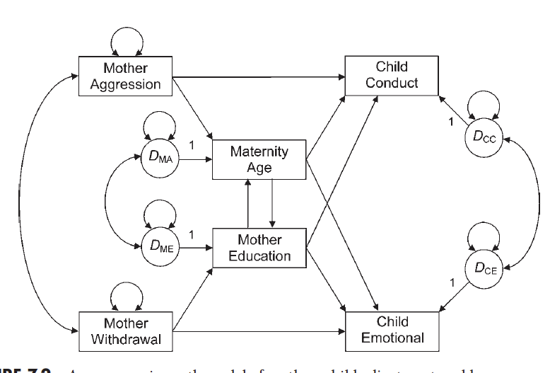
Mother example

Slide 29
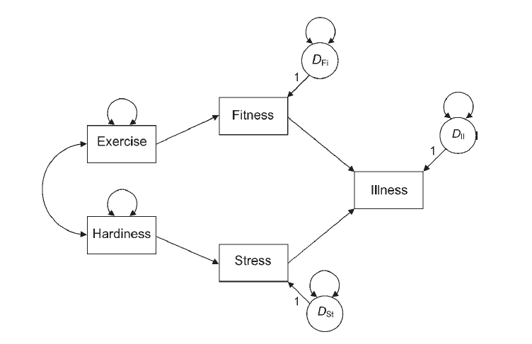
Exercise Example: Class Assignment

